Slide 1
Controllability of complex networks
Yang-Yu Liu, Jean-Jacques Slotine & Albert-Laszlo Barabasi
[1]
Yanna Ding, Nov 10

Slide 2
Controllability
Research question
What is the minimal set of nodes needed to fully control a network and drive each node to a desired state?

Slide 3
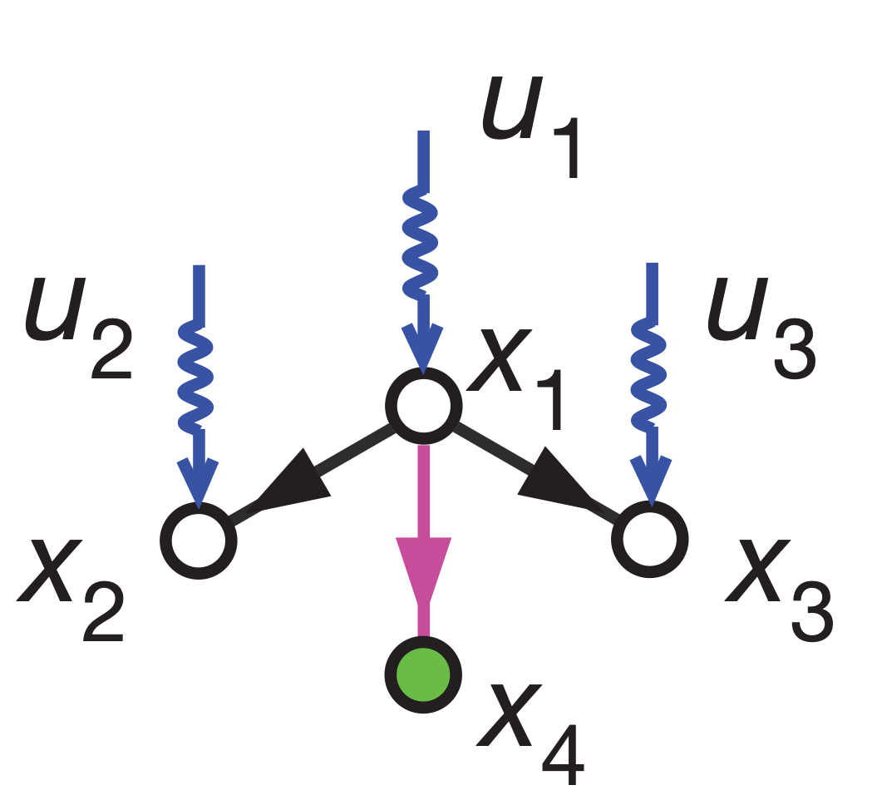
Controllability
Problem setup
The ODE describes the dynamics of a directed and weighted network G=(V,E)
State vector x(t) of size N
Input signal u(t) of size M <=> number of driver nodes
A: state matrix of size N x N; A_ij denotes the effect of node j on node i
B: input matrix of size N x M; B_ij is the weight that input signal u_j can affect node i
Controlled nodes: x1, x2, x3

Slide 4
Controllability
Kalman’s controllability rank condition
A linear control system is controllable if and only if the N x NM matrix
has full rank, i.e.,
Problems:
The link weights are noisy or unknown.
The condition is expensive to verify for huge networks

Slide 5
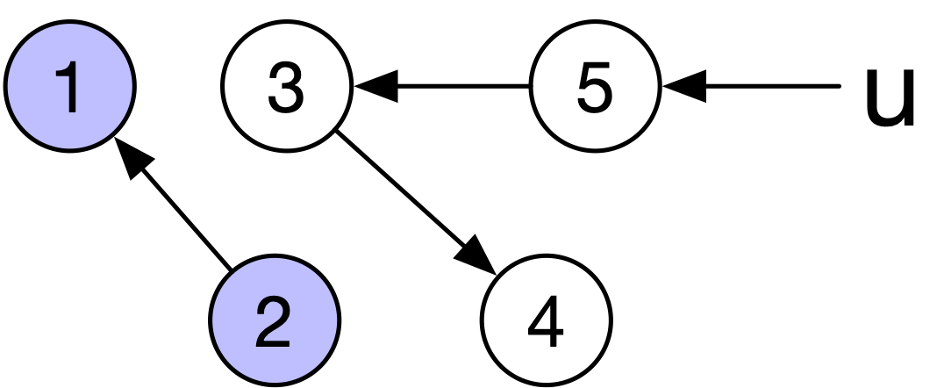
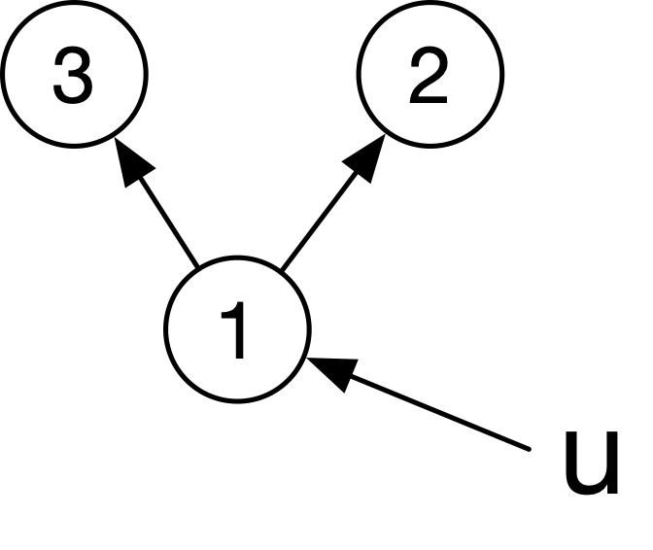
Control theory -> network topology
Structural controllability theorem by Lin et al: [2]
A linear control system is structurally controllable if G contains no dilation or inaccessible nodes.
Dilation
Inaccessible nodes

Slide 6
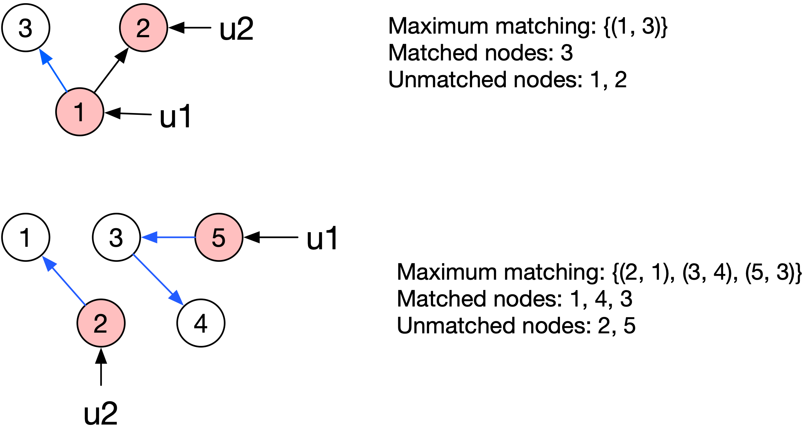
Proposed method
Maximum matching
Minimal set of driver nodes = unmatched nodes corresponding to any maximal matching
Matching: a set of edges with no shared starting/ending node
Matched node: an ending vertex of some edge in a matching
Unmatched node: V - {matched nodes}

Slide 7
Experiments
Controllability of real networks
Degree distribution
Synthetic network model
Average degree
Exponent of the degree distribution in scale free networks
Heterogeneity
Control robustness

Slide 8
Controllability of real networks
Network type | N | L | n_D
Regulatory | 7,253 | 6,726 | 0.820
Trust | 82,168 | 948,464 | 0.045
Food web | 183 | 2,494 | 0.541
Power grid | 4,889 | 5,855 | 0.325
Metabolic | 2,275 | 5,763 | 0.382
Electronic circuits | 512 | 819 | 0.232
Neuronal | 297 | 2,345 | 0.165
Citation | 34,546 | 421,578 | 0.232
World Wide Web | 325,729 | 1,497,134 | 0.677
Internet | 10,876 | 39,994 | 0.552
Social | 36,595 | 91,826 | 0.204
Intra-organizational | 77 | 2,228 | 0.013
n_D: the number of driver nodes divided by N.
A larger n_D implies the network is more difficult to control.

Slide 9
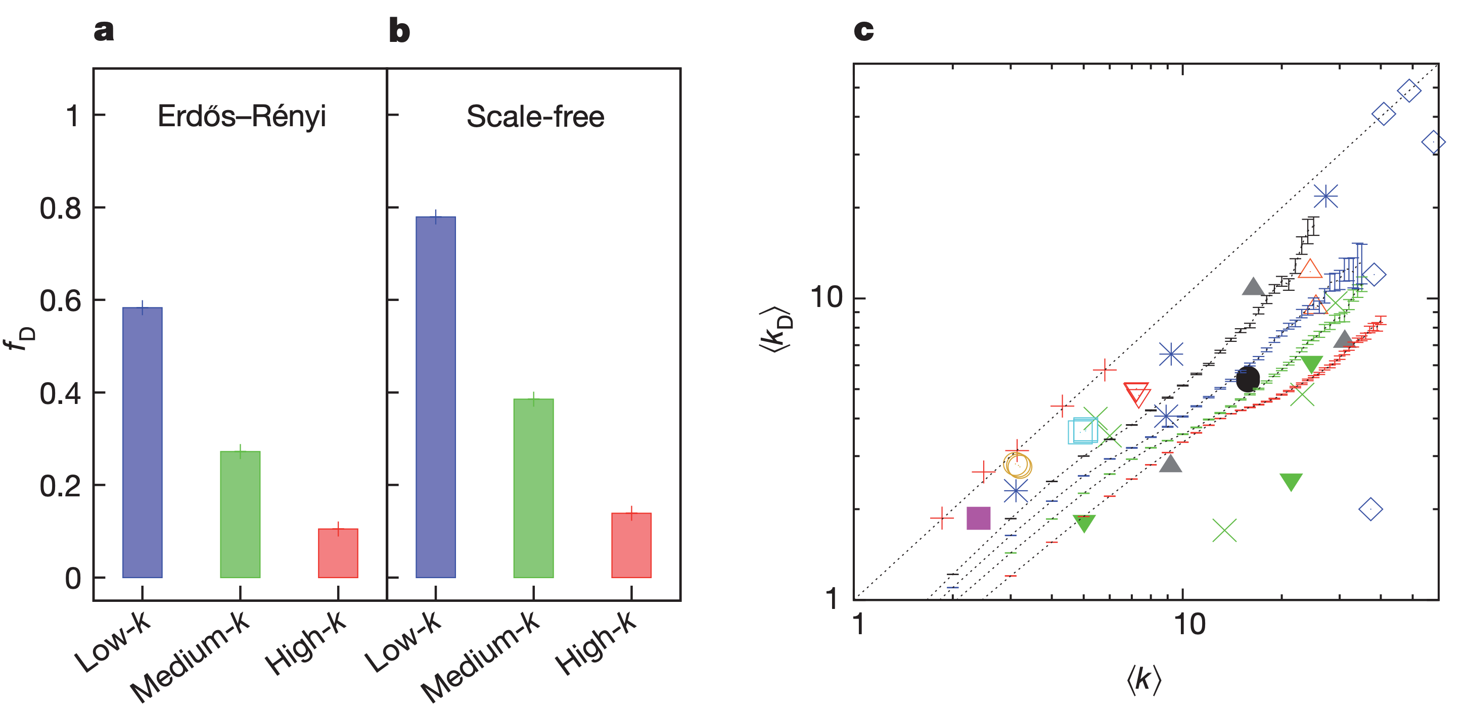
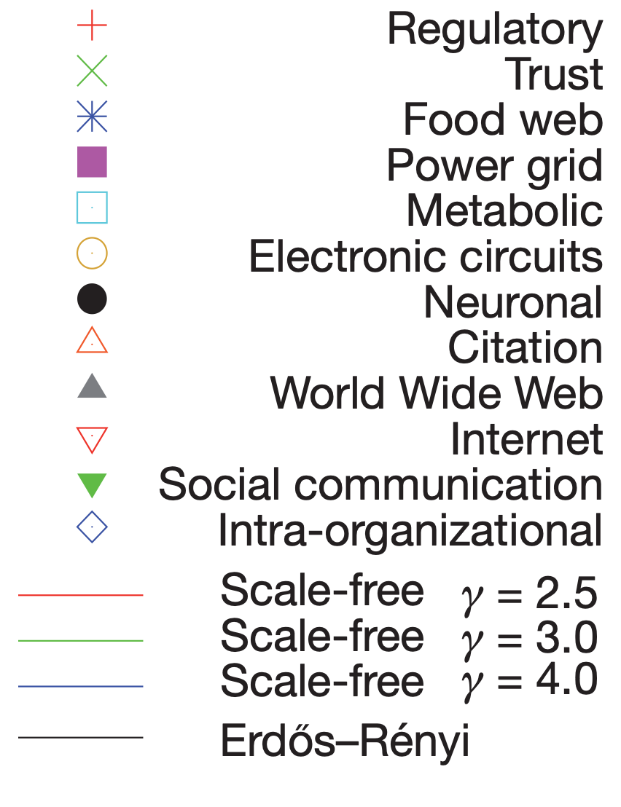
Driver nodes tend to avoid hubs
Hubs are more likely to be matched nodes.
f_D: number of driver nodes with low/medium/high degree divided by N
<k>: average degree of all nodes
<k_D>: average degree of driver nodes

Slide 10
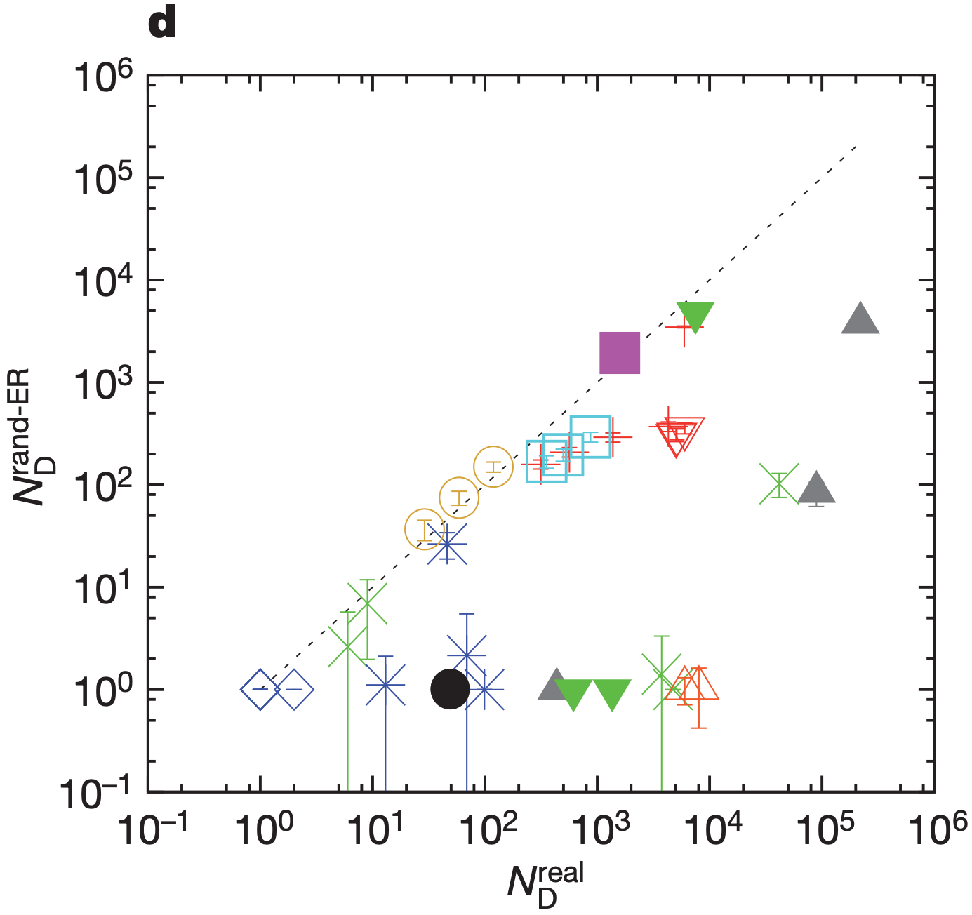
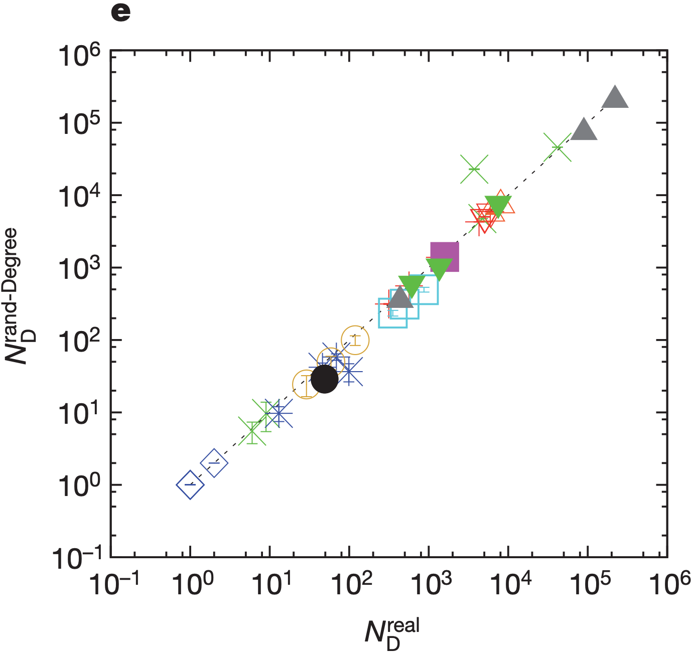
Degree distribution determines controllability
Real network —> rewired to obtain an ER network
Real network —> degree-preserving rewiring

Slide 11
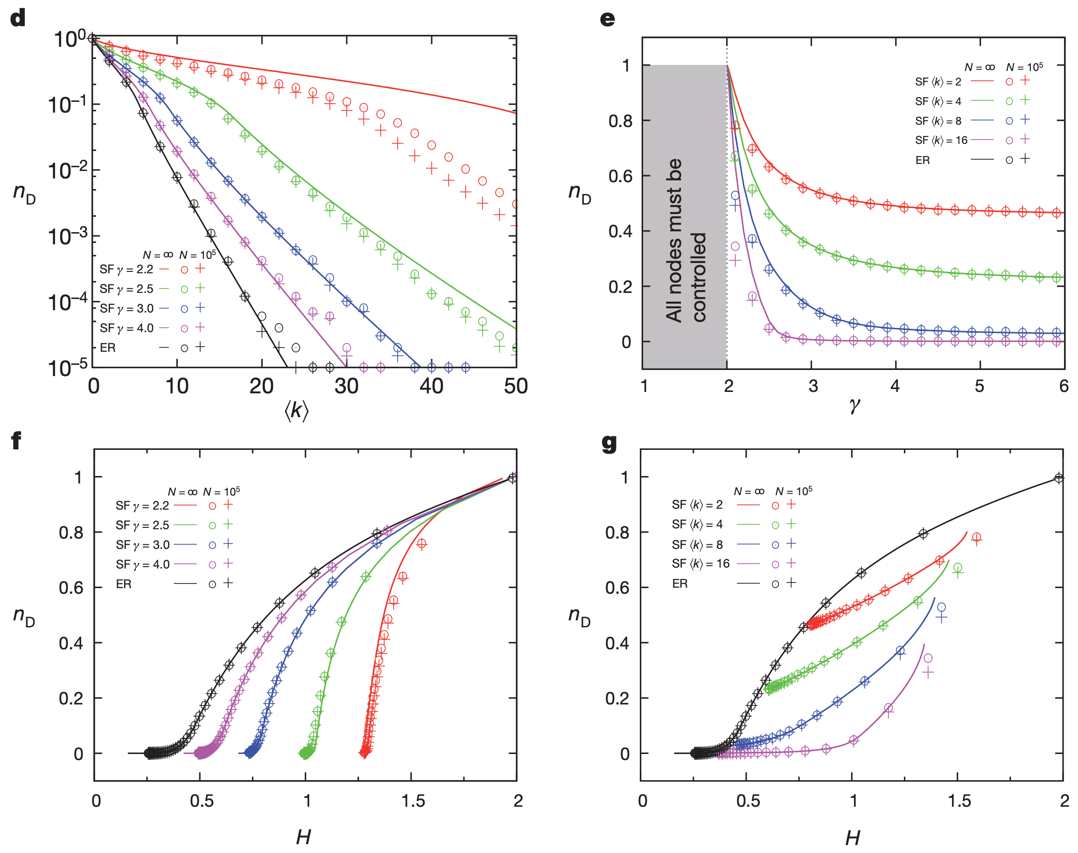
Synthetic networks
Average degree
Scale-free exponent
Heterogeneity

Slide 12
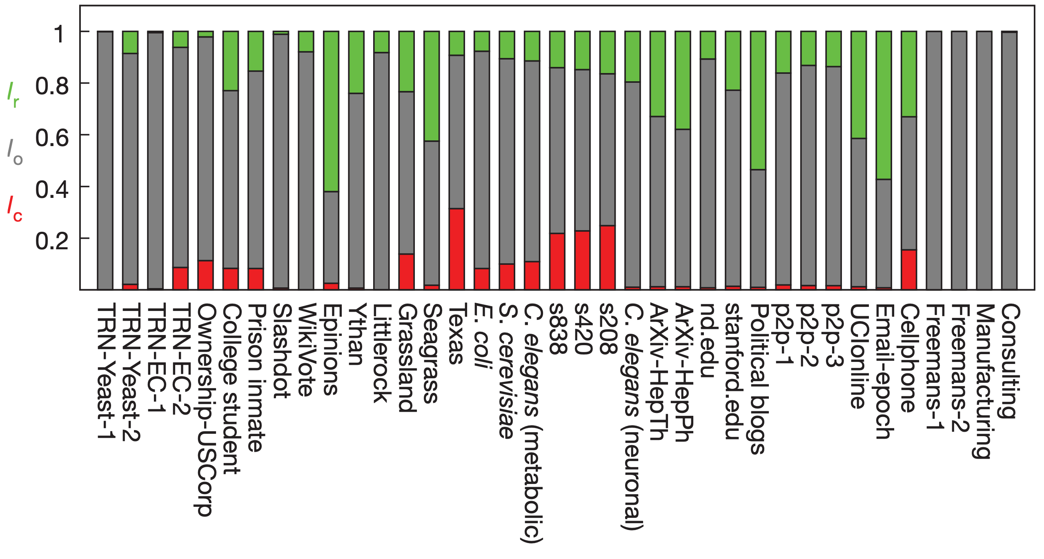
Control robustness
Link removal’s effect on controllability
Critical link
Ordinary link
Redundant link
I_r: fraction of redundant links
l_o: fraction of ordinary links
l_c: fraction of critical links

Slide 13
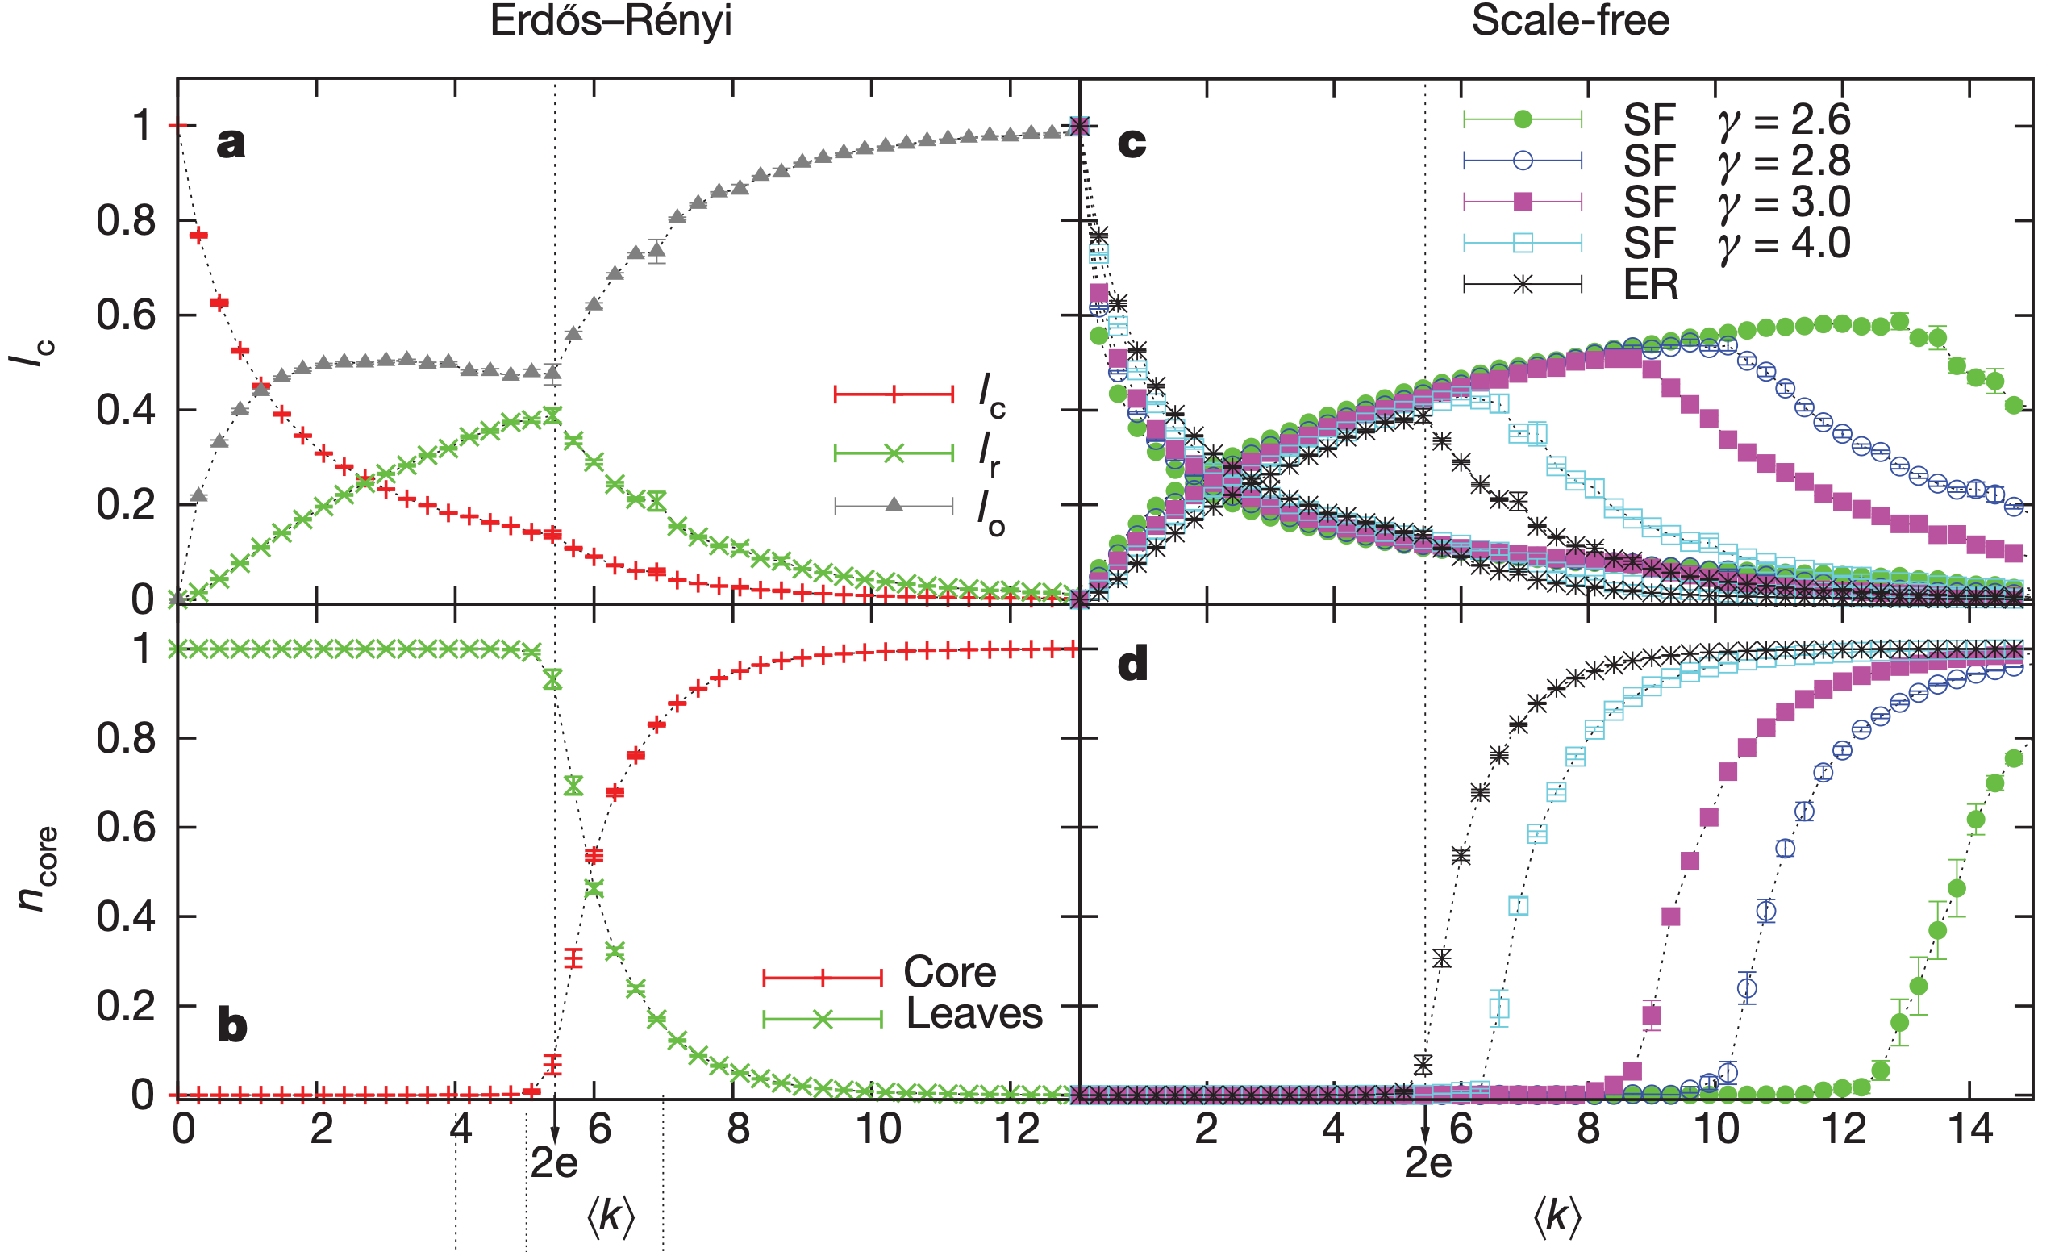
Control robustness

Slide 14
Evaluation
The proposed method can be applied to any network and can be used to systematically study the relationship between controllability and any graph property, such as degree correlation [3].
The authors separate out the contribution of dynamics and focus on how topology affects controllability. The identification of driver nodes completely rely on the adjacency matrix of the original network. The weights and dynamics are neglected.
In practice, we only have access to partial topology.

Slide 15
Extension
Can we estimate the fraction of driver nodes using partial topology?
Network | N | L | <k> | n_D
N1 | 20 | 21 | 5.8 | 0.35
N2 | 200 | 291 | 51.205 | 0.405
N3 | 500 | 751 | 126.252 | 0.392
N4 | 20 | 47 | 7.1 | 0.7
N5 | 200 | 425 | 51.875 | 0.865
N6 | 500 | 1098 | 126.946 | 0.828
Hypothesis: If the subgraph preserves the degree distribution, the fraction of driver nodes in the subgraph approximates the original fraction.
N1 - N3: ER
N4 - N6: scale free

Slide 16
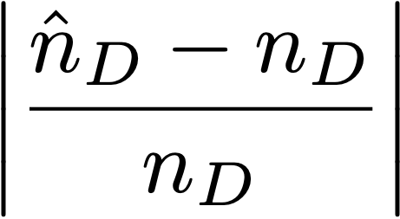
Partial topology
 | Sampling ratio
Network | 0.2 | 0.4 | 0.6 | 0.8
N1 | 1.143 | 0.429 | 0.190 | 0.071
N2 | 0.543 | 0.327 | 0.111 | 0.065
N3 | 0.607 | 0.314 | 0.122 | 0.020
N4 | 0.286 | 0.107 | 0.048 | 0.107
N5 | 0.075 | 0.075 | 0.017 | 0.025
N6 | 0.002 | 0.034 | 0.002 | 0.007
Sampling method (Pagerank based): A set of nodes is sampled with probability proportional to the pagerank of nodes and the induced subgraph is taken. [4]
Pagerank is computed with damping factor 0.5.
Experiments are repeated 100 times and the average result is reported.
Metric: relative error of the fraction of driver nodes

Slide 17
Partial topology
 | Sampling ratio
Network | 0.2 | 0.4 | 0.6 | 0.8
N1 | 1.014 | 1.064 | 1.019 | 1.064
N2 | 0.715 | 0.718 | 0.737 | 0.763
N3 | 0.765 | 0.763 | 0.768 | 0.764
N4 | 0.146 | 0.100 | 0.096 | 0.129
N5 | 0.087 | 0.028 | 0.021 | 0.041
N6 | 0.042 | 0.018 | 0.036 | 0.063
Sampling method (random node-edge): uniformly at random sample a node and then uniformly at random pick an edge incident to the node. [4]
This method performs the least well in preserving the degree distribution according to [4]

Slide 18
Partial topology
 | Sampling ratio
Network | 0.2 | 0.4 | 0.6 | 0.8
N1 | 0.916 | 0.658 | 0.418 | 0.251
N2 | 0.461 | 0.258 | 0.124 | 0.045
N3 | 0.446 | 0.235 | 0.105 | 0.043
N4 | 0.262 | 0.266 | 0.200 | 0.121
N5 | 0.142 | 0.080 | 0.050 | 0.026
N6 | 0.096 | 0.061 | 0.039 | 0.023
Sampling method: uniformly at random sample a node and then uniformly at random pick a node adjacent to it and capture the induced subgraph.

Slide 19
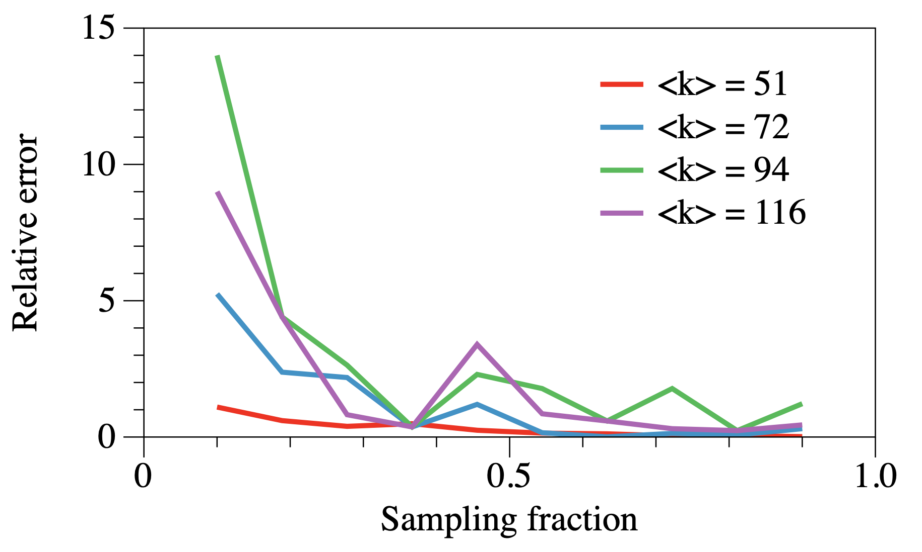
Partial topology
Average degree
ER N = 200
Sampling method: Pagerank based
# repetition = 200

Slide 20
Other questions
Does the removal of driver nodes affect network resilience more compared to hubs or other ordinary nodes?
Does this method work for nonlinear dynamics?

Slide 21
Reference
[1] Liu, Y.Y., Slotine, J.J. and Barabási, A.L., 2011. Controllability of complex networks. nature, 473(7346), pp.167-173.
[2] Lin, C.T., 1974. Structural controllability. IEEE Transactions on Automatic Control, 19(3), pp.201-208.
[3] Mayeda, H., 1981. On structural controllability theorem. IEEE Transactions on Automatic Control, 26(3), pp.795-798.
[4] Leskovec, J. and Faloutsos, C., 2006, August. Sampling from large graphs. In Proceedings of the 12th ACM SIGKDD international conference on Knowledge discovery and data mining (pp. 631-636).

